Slide 1
British Airways Data Science Project
Yuvraj Singh

Slide 2
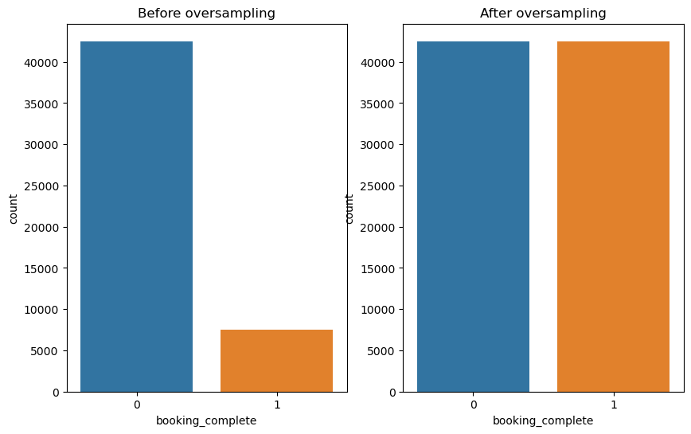
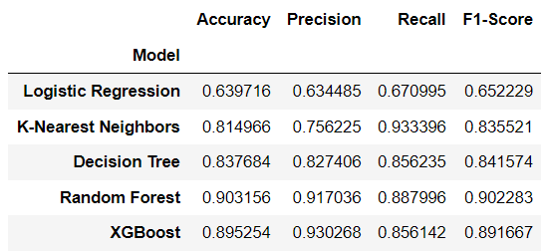
Summary (Task 2)
1) Total 50000 records, having ) null values
2) Imbalanced dataset, (85:15) for Output classifier.
3) Handled outliers present in purchase_lead, length_of_stay, num_passengers
4) Created some features like length_of_stay_category, avg_time, day_flight, weekend_flight, converted every categorical columns into numerics, mapped them with numbers.
5) Applied SMOTE() technique, oversampled.
6) Passed selected features on various ML Models like Logistic Regression, Decision Tree, Random Forest, KNN, XGBoost etc
7) Finalised XGBooost, without any hyperparameter tuning, with accuracy of 90%.

